Slide 1
Medical Expense Prediction

Slide 2
Business Problem
Predicting Medical Cost using Regression on medical cost dataset using the features to predict the Target variable i.e., cost/charges.
Features
age
sex
bmi
children
smoker
region
Target
charges

Slide 3
Attributes
Features
age : age of primary beneficiary
sex : insurance contractor gender, female, male
bmi : Body mass index, providing an understanding of body, weights that are relatively high or low relative to height , objective index of body weight (kg / m ^ 2) using the ratio of height to weight, ideally 18.5 to 24.9
children : Number of children covered by health insurance / Number of dependents
smoker : Does smoking (yes/no)
region : the beneficiary's residential area in the US, northeast, southeast, southwest, northwest.
Target
charges : Individual medical costs billed by health insurance

Slide 4
Resources
Kaggle: Platform from where the data was extracted for the analysis
Jupiter Notebook : used for Advance Python programming for Data analysis
Libraries used :
NUMPY
PANDAS
SEABORN
MATPLOTLIB
SCIKIT
SKLEARN

Slide 7
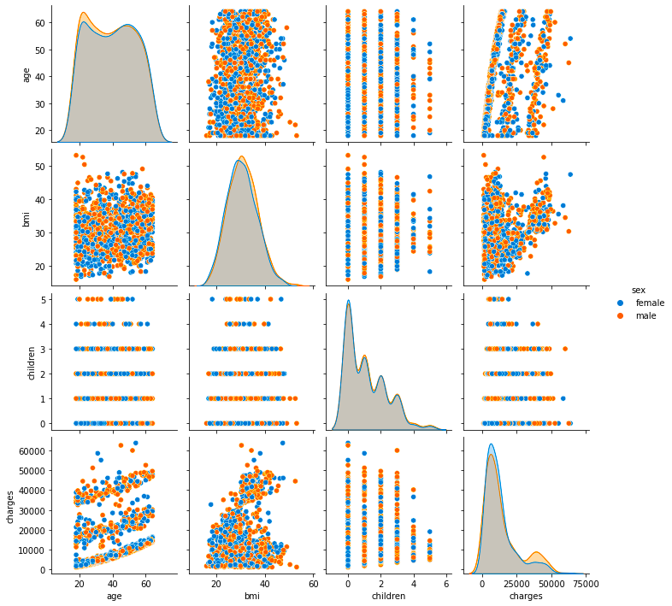
Pair Plot

Slide 8
Conclusion: People in north have lower bmi compared to people living in the south

Slide 9
Linear Regression

Slide 10
Decision Tree Regression

Slide 11
Random Forest Regression

Slide 12
Linear Regression = 75.13%
As the accuracy over here is around 75 %,so we changed the model to check the accuracy.
Decision Tree Regressor = 65.75%
In Decision Tree Regressor accuracy is lower than Linear Regression. So we move to Random Forest Regressor.
Random Forest Regressor = 84.20%
Random Forest Regressor is giving accuracy better than above all models, which is around 84%.
CONCLUSION:
So Random Forest is giving the best accuracy which is 84.20%.
Machine Learning models

Slide 13
Machine Learning models
As we know that our target variable is fare amount charged by the cabs. And fare charges are continuous variable.
So we decided to do supervised machine learning. Wherein there are 3 algorithms which are:
Linear Regression
Decision tree Regressor
Random Forest Regressor
So, we used these three, one by one and check the accuracy of the same.
According to the accuracy we decided which model should be used to predict the fare charges of the cab.

Slide 14
Thank You

